Slide 1


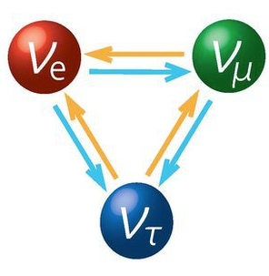


Development of LArTPCs for Neutrino Physics
Xin Qian
BNL
http://lar.bnl.gov/

Slide 2
Outline
Why LArTPCs for neutrino physics?
Challenges and path to 10s kT LArTPCs
Progress towards an automated event reconstruction
TPC signal processing
Wire-Cell tomographic event reconstruction
TPC cluster/PMT flash matching
Track trajectory and dQ/dx fitting

Slide 3
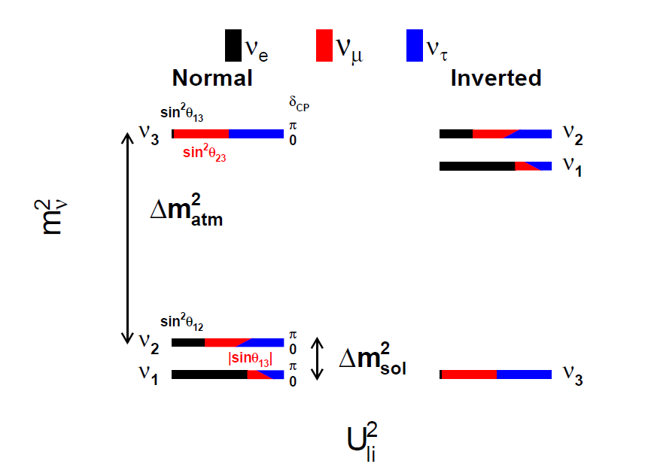
Big Questions in Neutrino Physics
Are neutrinos responsible for the large matter anti-matter asymmetry?
What’s the neutrino mass hierarchy?
Are neutrino Dirac or Majorana particles?
What is the neutrino mass?
Are there sterile neutrinos?
…

Slide 4
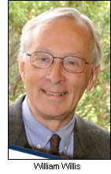
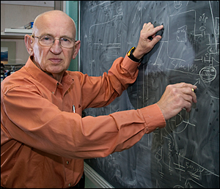
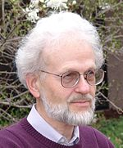
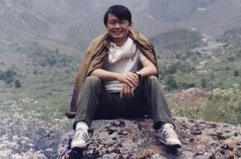
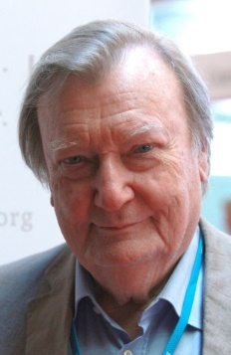
Early History of the Development of LArTPC
W. Willis and V. Radeka, Liquid argon ionization chambers as total absorption detector, NIMA 120:221 (1974)
D. R. Nygren, The Time Projection Chamber: A New 4π Detector for Charged Particles. eConf. C740805:58 (1974)
H. H. Chen et al. A Neutrino detector sensitive to rare process. I. A study of neutrino electron reactions. FNAL-Proposal-0496 (1976)
C. Rubbia, The liquid argon time projection chamber: a new concept for neutrino detector, CERN-EP/77-08 (1977)
V. Radeka
H. H. Chen
D. R. Nygren
C. Rubbia

Slide 5
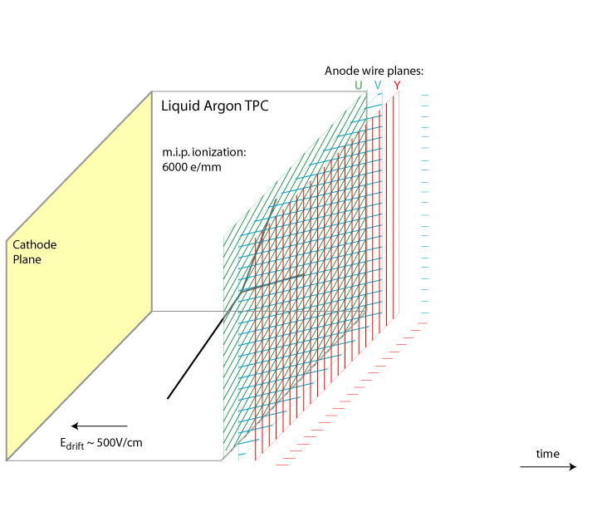
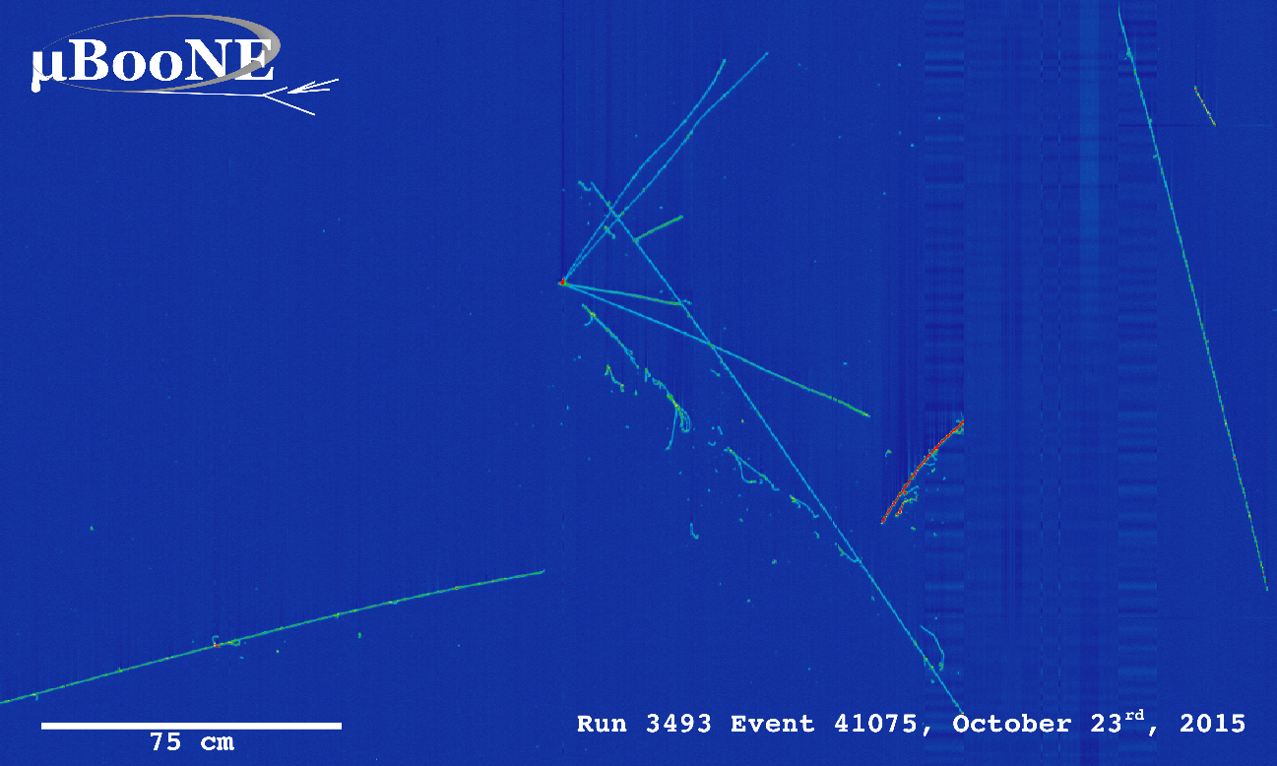
Principle of Single-Phase Liquid Argon Time Projection Chamber (LArTPC)
~mm scale position resolution with multiple 1D wire readouts
Particle identification (PID) with energy depositions and topologies
Made by Bo Yu (BNL)
time
Drift velocity 1.6 km/s → several ms drift time

Slide 6
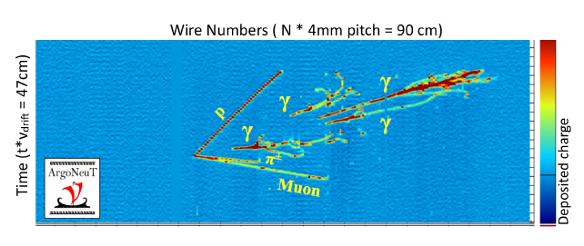
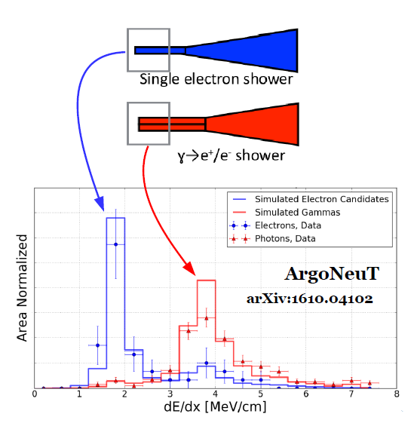
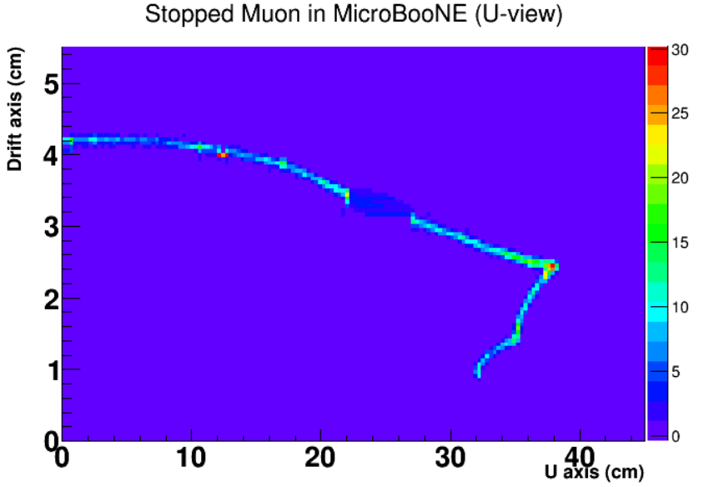
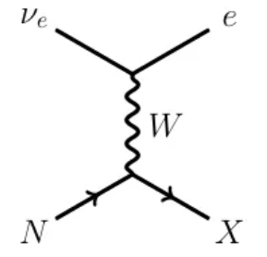
Unique capability to identify ν_{e} charge-current interactions in LArTPC
Comparison of P_{MCS} and P_{Range} to separate low-energy e/µ for ν_{e} charge-current interaction
Gap Identification + dE/dx to separate e/γ
Stopped muon
Dead ch.
Michel e

Slide 7
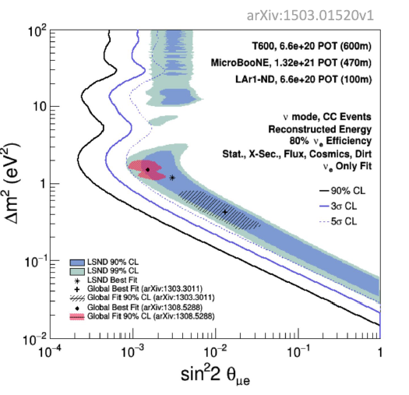
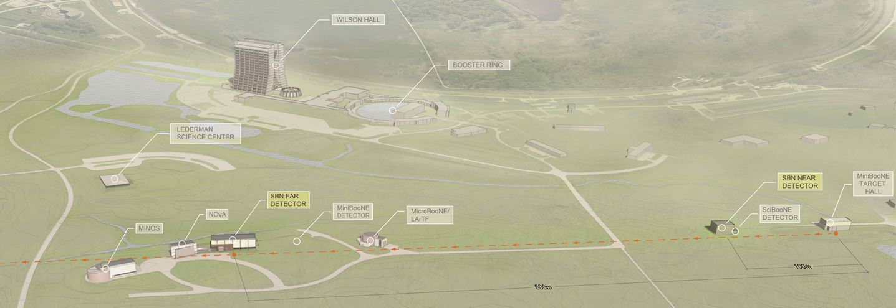
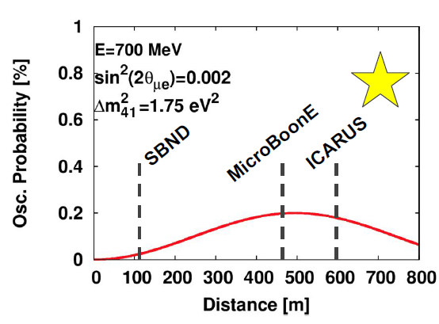
Short-Baseline Neutrino Program
Search for light sterile neutrino(s) through search for anomalous ν_{μ}→ν_{e} oscillation motivated by LSND and MiniBooNE anomalies

Slide 8
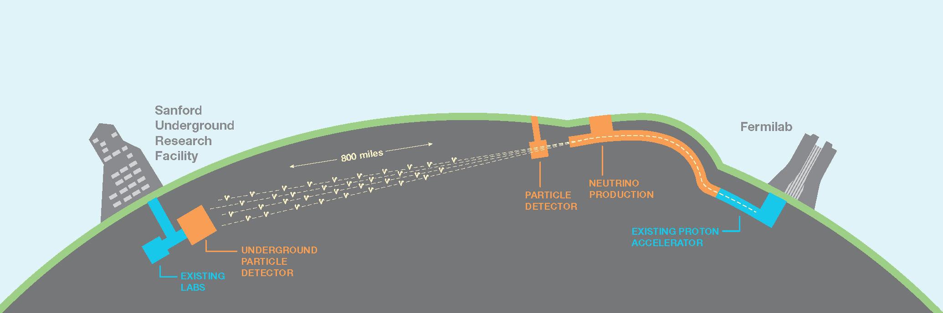
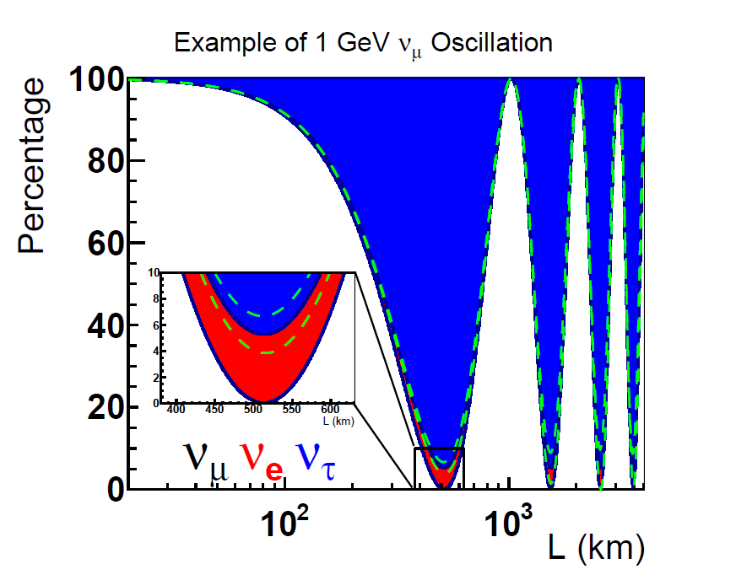
Deep Underground Neutrino Experiment (DUNE)
DUNE is designed to search for new CP violation, determine the mass hierarchy, test the unitarity of PMNS matrix through precision measurement of (anti)ν_{μ}→(anti)ν_{e} oscillation
Also search for proton decay and detect supernova neutrinos

Slide 9
Outline
Why LArTPCs for neutrino physics?
Challenges and path to 10s kT LArTPCs
Progress towards an automated event reconstruction
TPC signal processing
Wire-Cell tomographic event reconstruction
TPC cluster/PMT flash matching
Track trajectory and dQ/dx fitting

Slide 10
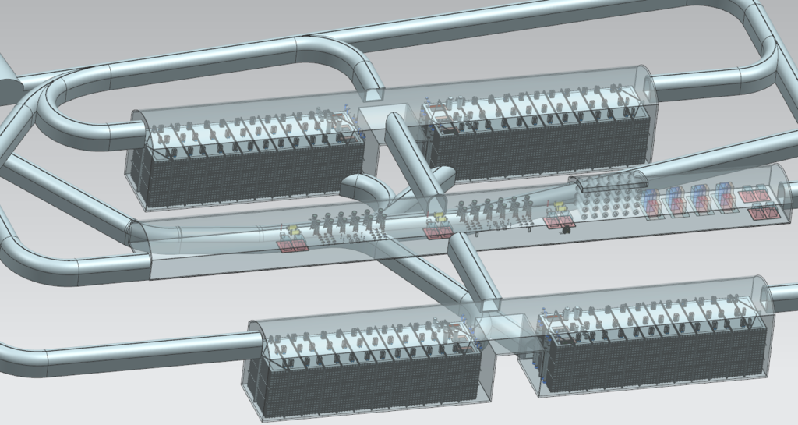
Why need massive LArTPC?
Neutrino interaction rate is approximately independent from neutrino energy and baseline
Given
Neutrino cross section ~ 10⁻³⁸ cm² x Energy (GeV)
Neutrino flux ~ 10¹⁷ /m²/10²⁰ (Proton On Target)
Required precision on appearance probability
We need at least 10s kiloTons of target mass
Four 10 kT fiducial (17 kT total) LArTPCs 4850 feet underground

Slide 11
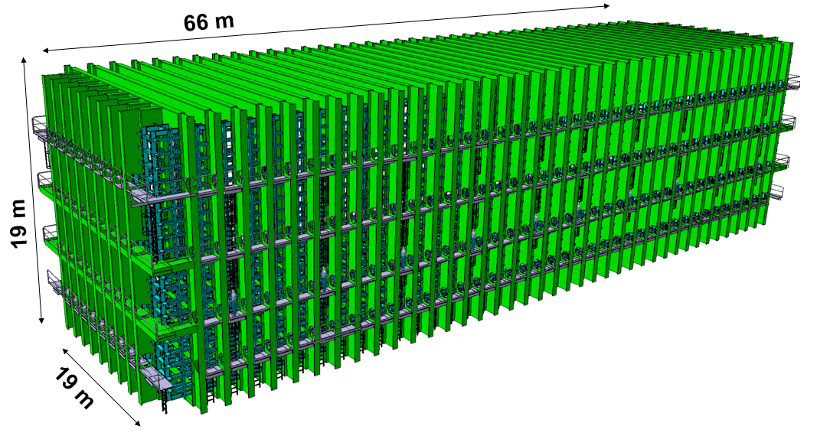
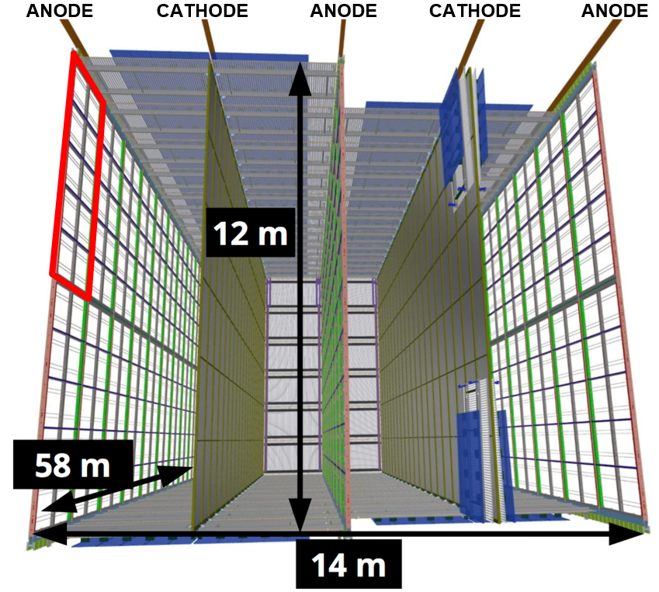
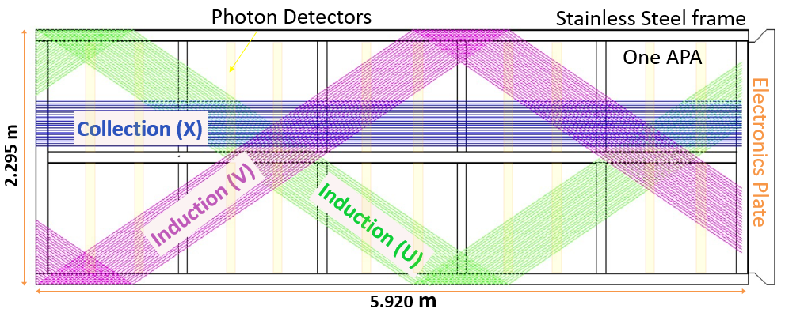
The First 10 kT Module of DUNE
Cryostat
150 APAs with 2560 readout channels each within three (1D) wire planes (~ 5 mm pitch)
Cost and power consumption of electronics in LAr
Anode Plane Assembly (APA)

Slide 12
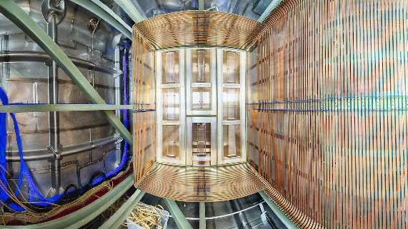
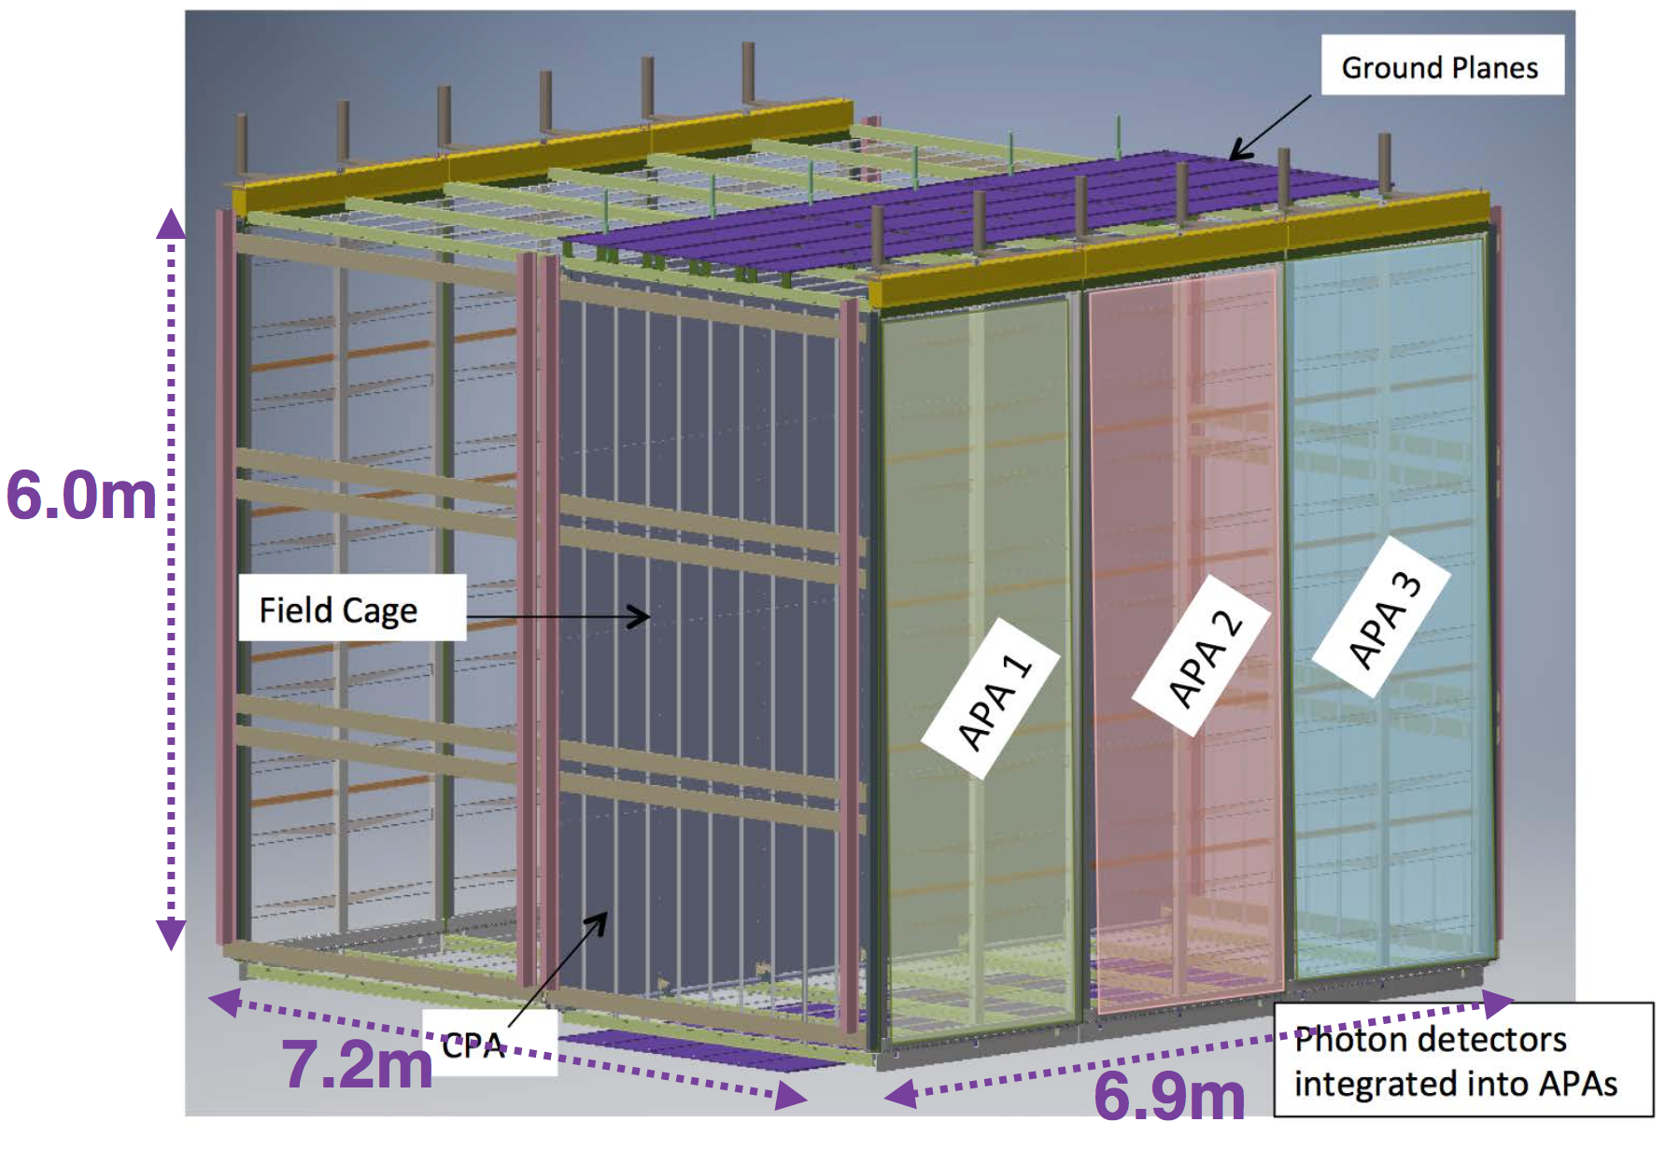
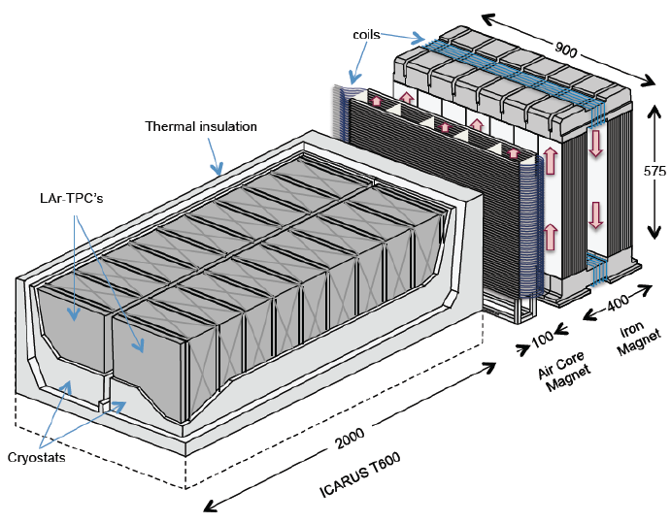
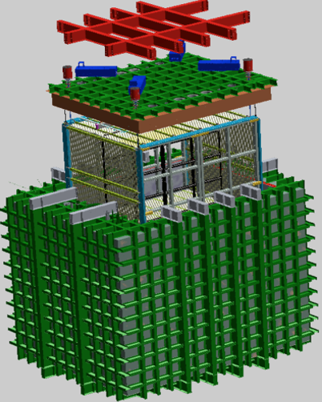
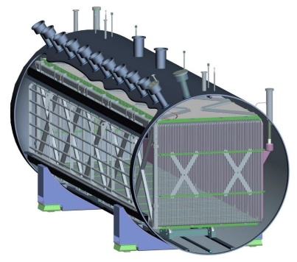
Path towards 10 kT Single-Phase LArTPCs
35-ton prototype
ProtoDUNE (NP04)
2001-2012
DUNE reference design
LBL
ICARUS
2014-2018
2018-2020
46 times larger than ICARUS
SBL
Also ArgonNeuT
Also development of dual-phase technology
MicroBooNE
SBND

Slide 13
Summary of Challenges
How to build and operate massive LArTPCs economically?
Industrial construction, quality control of detector components
Maintain ultra LAr purity, high voltage …
How to reach the ultimate performance of LArTPC for physics?
Ultra high resolution → massive amount of information recorded
Requirement of massive detector → push the redundancy to the minimum
Massive, but still not obviously sufficient amount of information recorded in LArTPC → a big challenge for automated event reconstruction

Slide 14
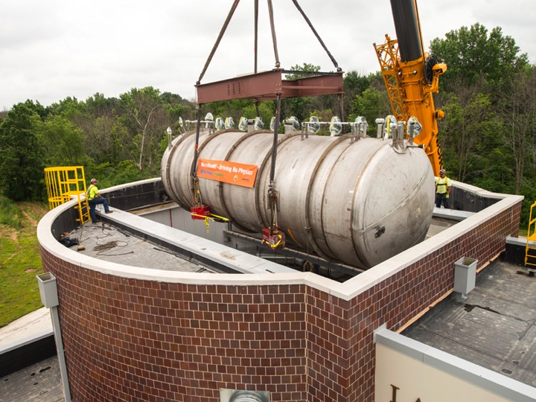
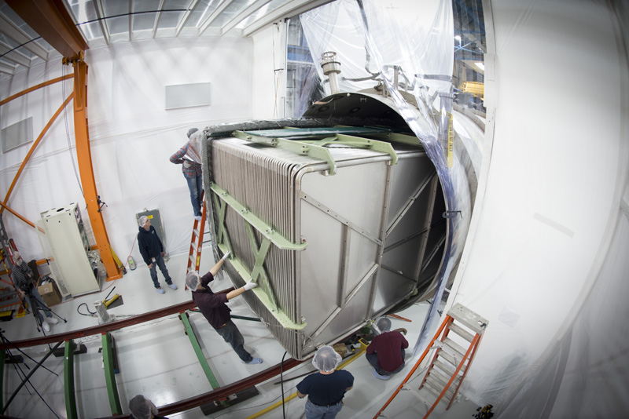
Technology Development in MicroBooNE
Physics motivation:
Understand the low-energy excess in MiniBooNE
Measure ν-Ar cross sections
Develop LArTPC technology

Slide 15
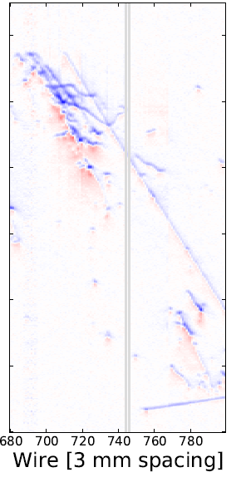
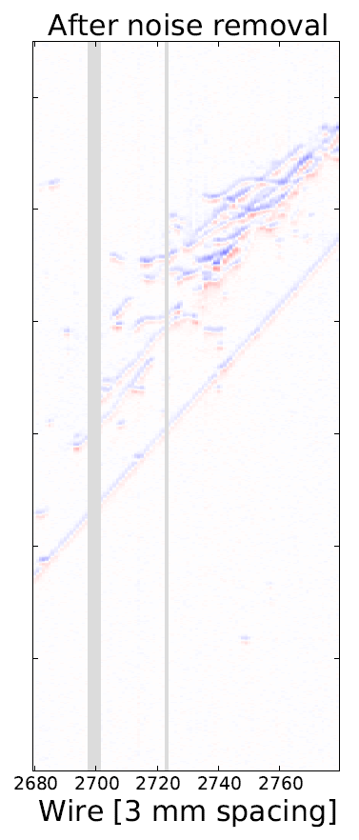
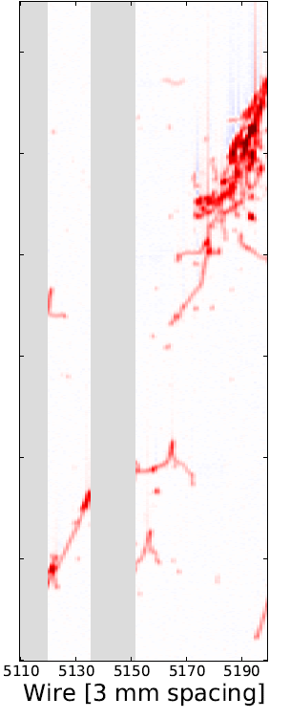

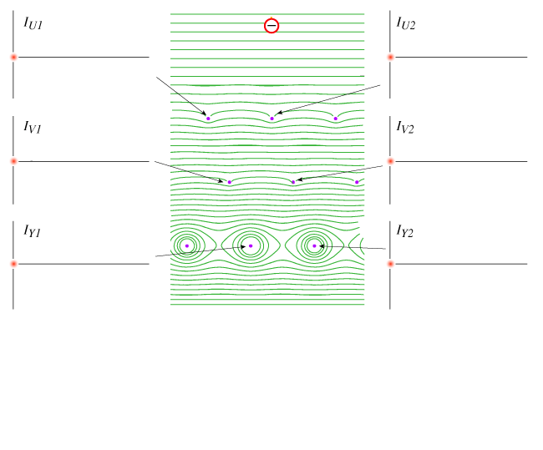
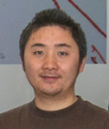
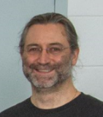
TPC Signal Formation
Induction U bipolar shape
Induction V bipolar shape
Collection Y unipolar shape
Attenuation due to attachment
Energy deposition
Wire pitch
Recombination
Nature of induction (long-range, position-dependent, following superposition principle) → smaller induction plane signals
Bo Yu
Small ionization signal in LAr → multiple wire planes with non-destructive induction readouts
Enabling technology: cold electronics
Yichen Li
Brett Viren

Slide 16
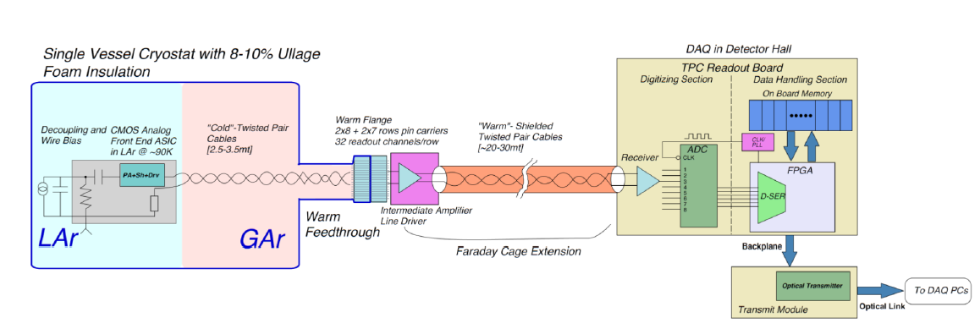
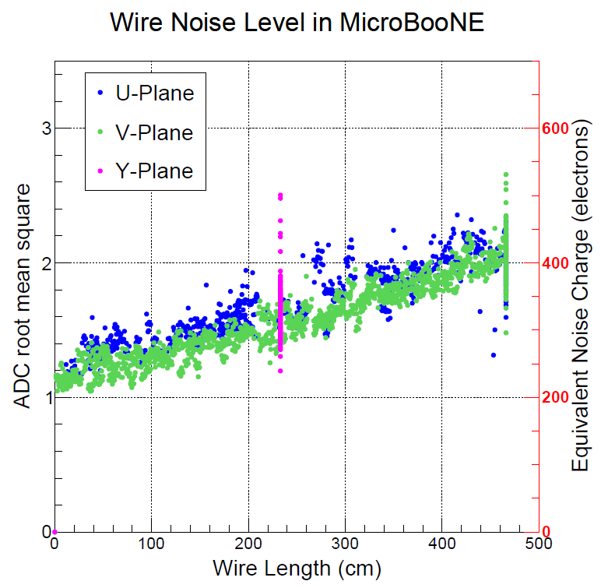
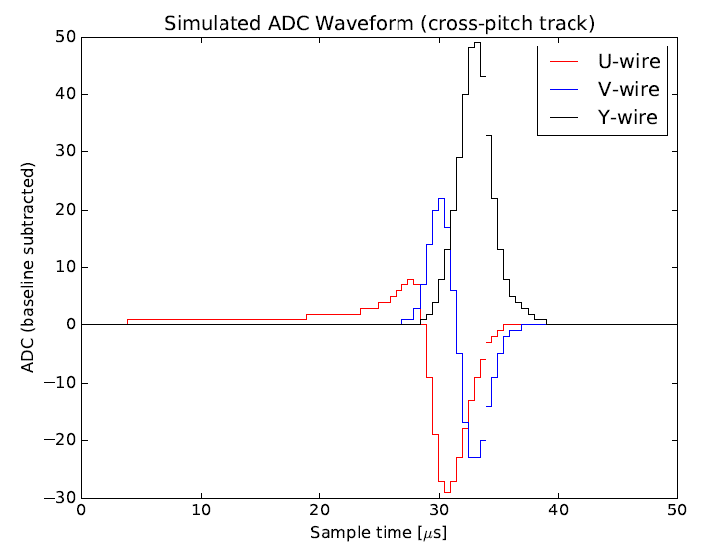
Cold Electronics
Placing the preamplifier inside LAr significantly reduced the electronics noise
5-6 times compared to past warm electronics → 60:1 MIP peak-to-noise ratio in the collection
Significantly improve the performance of induction wire plane → An enabling technology
1st International Workshop towards the Giant Liquid Argon Charge Imaging Experiment (2011)
JINST 12 P08003

Slide 17
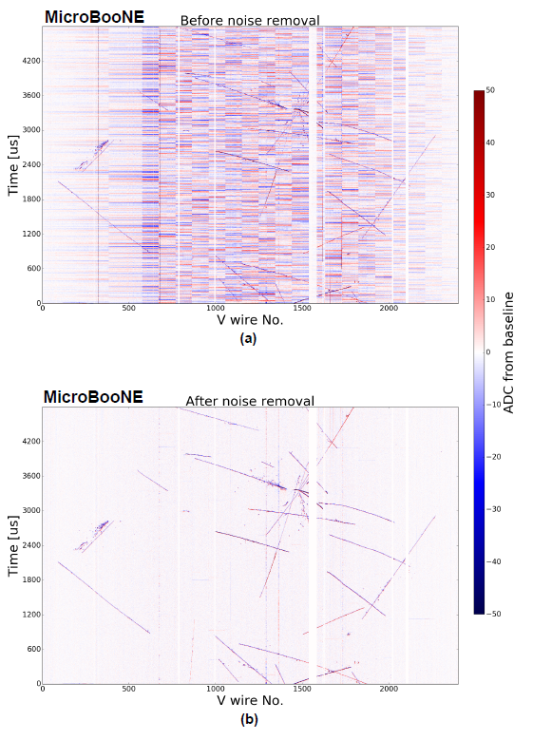
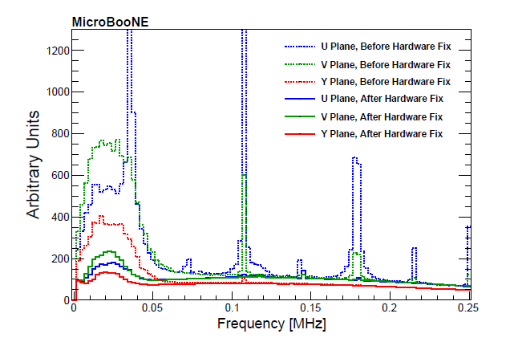
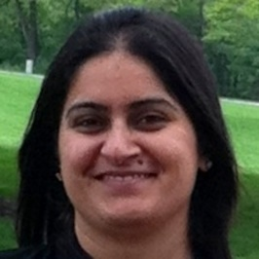
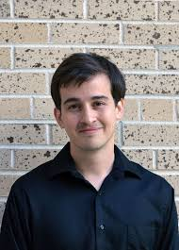
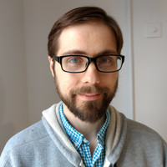
Excess Noise Removal
Excess noise during initial phase caused by voltage regulator and HV power supply
Software mitigation
Identified noise sources and developed both hardware fix and software mitigation
JINST 12 P08003 (2017)
Jyoti Joshi
Brian Kirby
Mike Mooney
Notes:
Regulartor and HV power supply noise … 1 year

Slide 18
TPC Signal Processing → Recover (or Unfold) Ionization Electrons
Time domain
Signal processing is based on deconvolution technique
O(N³) matrix inversion is achieved through a O(N logN) fast Fourier transformation
Top 10 algorithms in 20th century
1-D deconvolution described in B. Baller “Liquid Argon TPC Signal Formation, Signal Processing, and reconstruction techniques”, JINST 12, P07010
Fourier transformation
Frequency domain
Back to time domain
Inverse-Fourier transformation

Slide 19
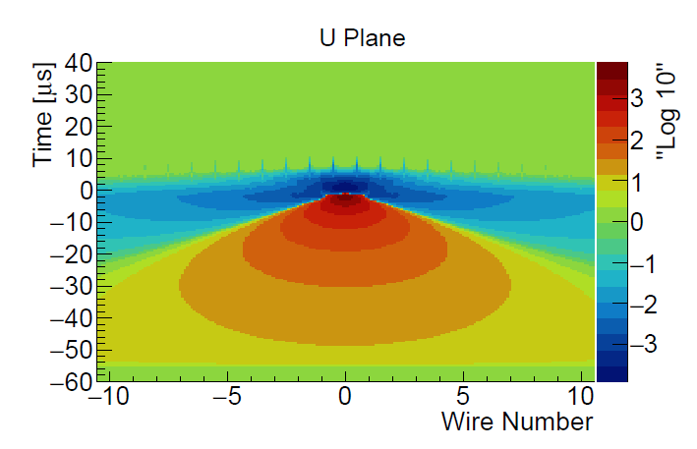
2-D Deconvolution
Position-dependent responses
With induced signals, the signal is still linear summation
R₁ represents the induced signal from i+1th wire signal to ith wire
S_{i} and S_{i+1} are not directly related
The inversion of matrix R can again be done with deconvolution through 2-D Fast Fourier Transformation
Also, Region of Interest (ROI) is essential to deal with the induction wire plane signal

Slide 20
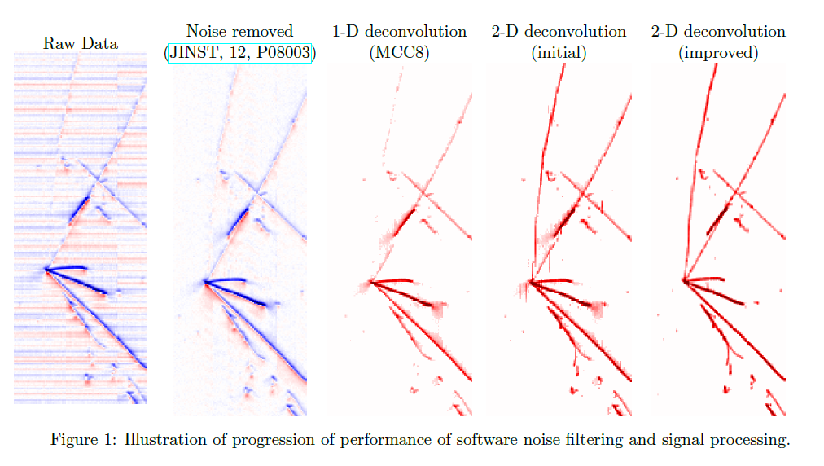
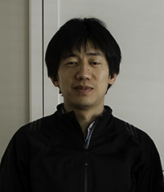
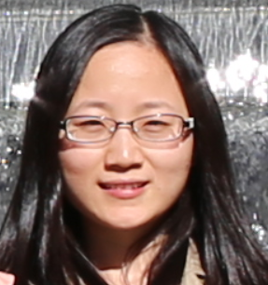
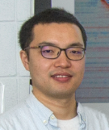
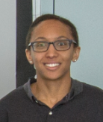
Improved Signal Processing: “2D Deconvolution”
Number of ionized electrons
Applied signal processing concepts to general data unfolding problem:
“Data Unfolding with Wiener-SVD Method”, W. Tang, X. Li, XQ, H. Wei, C. Zhang, JINST 12, P10002
Field Response
Drift Time
Signal on Wire Plane
Electronic Response
Signal to be digitized by ADC
(Signal Processing)
Number of ionized electrons
Wire number
JINST 13 P07006/7 (2018)
Wei Tang Xiaoyue Li
Hanyu Wei Brooke Russell

Slide 21
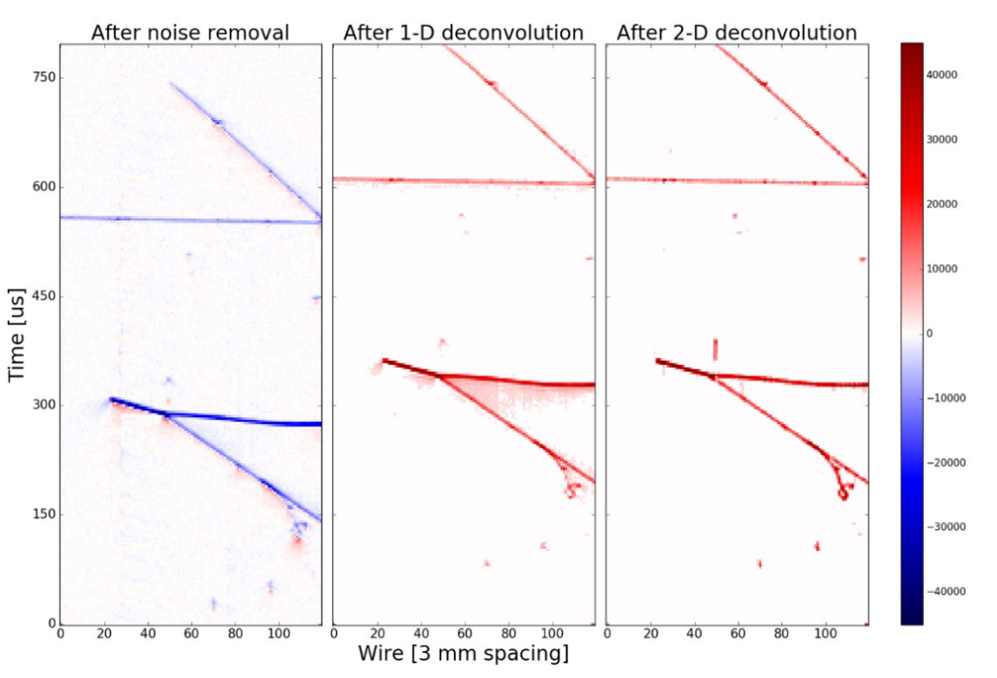

Induction U plane
Collection plane
http://lar.bnl.gov/magnify/

Slide 22


Outline
Why LArTPCs for neutrino physics?
Challenges and path to 10s kT LArTPCs
Progress towards an automated event reconstruction
TPC signal processing
Wire-Cell tomographic event reconstruction
TPC cluster/PMT flash matching
Track trajectory and dQ/dx fitting

Slide 23


Traditional Reconstruction Approach: 2D matching → 3D
2D pattern recognition
Matching to 3D objects
Error made in pattern recognition will propagate to the later reconstruction steps

Slide 24



Wire-Cell Tomographic Event Reconstruction
“Three-dimensional Imaging for Large LArTPCs”, XQ, C. Zhang, B. Viren, M. Diwan, JINST 13, P05032 (2018)

Slide 25


Solving: usage of Charge, Sparsity, Positivity, Connectivity
Brett Viren
Chao Zhang
The goal is to differentiate the true hits from fake ones by using the charge information
~ large charge → true hits ~ zero charge → fake hits
Sparsity, positivity, and connectivity information are added through compressed sensing (L1 regularization)
E. Candes, J. Romberg, T. Tao
arXiv-math/0503066

Slide 26


Demonstration of Charge Matching
Mike Mooney
Old 1D
Signal Processing
New 2D
Signal Processing
Brian Kirby
JINST, 13, P07007
Notes:
One set of plots … First time ever in LArTPC to reach charge matching …

Slide 27






Wire-Cell on the MicroBooNE Data
2015, after several hours of CPU running
Bee link
(upper) 1D deconvolution + L0 compressed sensing
2018, 3 mins of CPU running
Bee link
(lower) 2D deconvolution + L1 regularization
JINST 13, P05032 (2018)
Notes:
Significant improvement in SP and … write something … why is better ??? Remove last line, more dots → more hits, high efficiency …

Slide 28



Wire-Cell on MicroBooNE Data
Hanyu Wei Xiangpan Ji
A set of 3D clustering algorithms is developed based on data events
The damage of 10% dead channels can be sufficiently mitigated in the reconstruction

Slide 29

Outline
Progress towards an automated event reconstruction
TPC signal processing
Wire-Cell tomographic event reconstruction
TPC cluster/PMT flash matching
Track trajectory and dQ/dx fitting
~ 1:200

Slide 30



Challenge in Selecting Neutrinos
LArTPC is a slow detector, running on surface leads to significant challenges in selecting neutrinos
The key is to associate the correct T₀ (light info.) to the corresponding TPC cluster
Compressed Sensing with L1 regularization!
4.8 ms drift window
20-30 TPC activities

Slide 31




Matching Principle
4.8 ms drift window
Matching Hypotheses
Clustering
3D Image
Light Reconstruction
Hypotheses Selection
20-30 TPC activities
All possible hypotheses
One flash → many or zero TPC clusters within corresponding active volume (activities in inactive volume)
One cluster → at most one flash (inefficiency in the light system)
Light signal proportional to (reconstructed 3D) charge
Known light acceptance given position
Predicted vs. Measured light pattern with Compressed Sensing

Slide 32
Core Charge-Light Matching Algorithm
Overall test statistics to be minimized
Comparison of the measured and predicted light pattern
Each Charge Cluster can only be used once
Observed light flash may not correspond to any charge cluster
Aggressively pursue charge-light matching
Additional cuts to examine the “light mismatch” events
Compressed sensing to select the best pairs

Slide 33






Performance
Side view
Top view
The Geant4-based simulation for neutrino interactions with above 90% accuracy in Charge-Light Matching
Front view
MicroBooNE Simulation
In Progress
$ν_{μ}$ CC interactions
in active volume
Completeness: overlap over true
Purity: overlap over reco [ghost, over-clustering, etc.]

Slide 34




LArTPC Charge-Light Matching
Side view
Top view
Front view
After 3D Imaging
Procedure | Neutrino : Cosmic Muons
Trigger | 1 : 800
PMT filter (late light rejection) | 1 : 200
Many-to-many charge-light Marching | 1 : 7
After Charge-Light Matching

Slide 35




Application of Matching: Space Charge Boundary
Anode
E field (X)
Rejection of in-beam-time through-going muons with correct active volume boundary
Cathode
Vertical Direction (Y)
Vertical Direction (Y)
Beam Direction (Z)
Vertical Direction (Y)
After correcting t₀ for all cosmic muons in one event
Drift direction (X)
Neutrino : Cosmic Muons = 1 : 1 after rejecting through-going muons
Major background is stopped muons

Slide 36


Outline
Progress towards an automated event reconstruction
TPC signal processing
Wire-Cell tomographic event reconstruction
TPC cluster/PMT flash matching
Track trajectory and dQ/dx fitting
Important for e/gamma separation, stopped muon rejection, and general particle identification (on-going development)
Example of (in-beam) stopped muon

Slide 37




Principle of the Fit
Come up with a 3D track hypothesis (3D trajectory points and dQ/dx)
Predict the deconvolved signals on all projection views
Minimize the difference between the observation and prediction
U view
V view
W view
Inspired by the Projection Matching Algorithm (R. Sulej and D. Stefan)

Slide 38

Simplified Prediction of the Deconvolved Signal
dQ/dx at generation
diffusion
Electron at anode plane
Convolve with field res.
Induced current on wires
Charge
At signal processing stage, we have two additional effects:
Software filters (time and wire dimension)
Usage of position-averaged overall response function
Simplified model
Convolve with elec res.
Pixel # in 2D Projections
Deconvolved signal
Signal Processing Chain
Digitized amplified current
Full process of signal formation and signal processing is complex → significant burden in computation
A simplified model was developed

Slide 39



Trajectory and dQ/dx Fitting
Unknowns
Measurements
Displacement to truth information
Notes:
https://www.phy.bnl.gov/twister/bee/set/692f6401-5e2d-45e1-94ba-b1f510db4b1b/event/1/

Slide 40



PID Performance on Monte Carlo
London Cooper-Troendle
Wenqiang Gu

Slide 41




Performance on Data (Stopped Muon)
Drift direction
Vertical
Drift direction
Beam direction
Bragg peak
Vertical
U View
V View
Compact in W view
Dead chs.
U View
V View
W View

Slide 42



Performance on Data (2 vs. 1 MIP)
2 MIP
1 MIP
U View
V View
W view
Dead chs.

Slide 43

Generic Neutrino Selection
MicroBooNE preliminary with Wire-Cell reconstruction
???
Stay Tuned
~ 30% efficiency with fully contained cuts
Half of cosmic backgrounds are caused by inefficiency in light system (activities at the cathode plane)
With the ongoing development of stopped muon tagger and additional cosmic tagger, targeting
Factor of three increase in efficiency
Factor of two reduction in cosmics

Slide 44





Noise Filtering &
ADC Mitigation
TPC Signal Processing
3D Image Reconstruction
3D Clustering
Track/shower separation, PID & Event ID
3D Pattern Recognition
Trajectory fitting and dE/dx reco.
TPC/PMT flash matching
Neutrino Energy Reconstruction
LEE and Cross section analyses
Summary
LArTPC is a crucial detector technology to answer many remaining questions in neutrino physics
The development of LArTPC technology is building a solid foundation for next discoveries with neutrino oscillation in coming decades
DUNE FD, SP
ProtoDUNE SP
MicroBooNE
SBND

Slide 46


Challenges of Event Reconstruction in LArTPCs
Event topology:
Tracks, showers, unknown vertex in LArTPCs
Simple tracks in collider’s gas TPCs
Wire vs. Pixel readout
Large LArTPCs has to use wire readout due to power consumption of electronics and costs
Puedo-3D detector
Dilemma of “vast amount of information” vs. “insufficient of information”

Slide 47





Why LAr?
Atomic Number | 2 | 10 | 18 | 36 | 54
Boiling Point [K] @ 1atm | 4.2 | 27.1 | 87.3 | 120 | 165
Density [g/cm³] | 0.125 | 1.2 | 1.4 | 2.4 | 3
Radiation Length [cm] | 755.2 | 24 | 14 | 4.9 | 2.8
dE/dx [MeV/cm] | 0.24 | 1.4 | 2.1 | 3 | 3.8
Scintillation [γ/MeV] | 19,000 | 30,000 | 40,000 | 25,000 | 42,000
Scintillation λ [nm] | 80 | 78 | 128 | 150 | 175
Cost ($/kg) | 52 | 330 | 5 | 330 | 1200
LAr combines abundant signal (ionization/scintillation), good dielectric, low diffusions, and low cost http://lar.bnl.gov/properties/

Slide 48








Summary of Wire-Cell Reconstruction
LArTPC Signal Formation
Noise filtering and Signal Processing
3D Imaging
Improved TPC signal simulation (long-range and fine-grain)
Enabled the robust usage of induction wire planes in reconstruction
deconvolving
slicing
tiling
Trajectory and dQ/dx fitting for PID
Solved the 2D projections→3D problem independent of event topology
JINST 12 P08003
JINST 13 P07006, P07007
solving
TPC/Light Matching
Solution for precision PID?
fitting
Conquered the general Charge/Light matching challenge
3D pattern recognition
matching
clustering
recognizing
Early development exists, need to revisit
MicroBooNE neutrino selection paper under preparation
JINST 13, P05032
MicroBooNE imaging paper under preparation

Slide 49


Signal Processing Evaluation
Quantitative evaluation of the signal processing chain → inefficiency for prolonged tracks (large-angle) track
4-wire plane proposal for DUNE
JINST, 13, P07006

Slide 50


Calibration of Electronics Response
Observed imperfect response due to “imperfect pole cancellation”
Significantly reduced in the newer generation of ASICs
Developed a procedure to calibrate out imperfect electronics response
Being applied to protoDUNE for ADC nonlinearity calibration
SP part II: JINST, 13, P07007
Led by BNL in collaboration with CSU
Notes:
Get rid of this one

Slide 51



SP for shorted-Y region
L1 (compressed sensing) became a good solution to the signal processing in the V-Y shorted region
Powerful new technique first introduced in LArTPC by BNL group
Thorough understanding of MicroBooNE detector achieved!
JINST, 13, P07007
Notes:
Math and computing (important technique developed, BNL brought in these for LArTPC PS and reconstruction), underdetermined system

Slide 52




Challenges in Clustering (I)
Gap as a result of Noise Filtering
Gap as a result of Signal Processing
(Left) coherent noise subtraction may remove signal when the S/N is small
(Right) signal recovery for prolonged track in the induction wire plane is a difficult task
Drift Time
Drift Time
Projected Induction V view
Projected Induction U view

Slide 53



Challenges in Clustering (II)
Gaps as a result of non-functional channels
Random Coincidence in ionization electron arrival time
Before separation
Grey regions are with two non-active wire planes (2/3)
In average about 10% dead channels in MicroBooNE → 3% dead regions requiring 2/3 planes in image reconstruction
After separation

Slide 54




Example of Actual Algorithm for Clustering
Many advanced techniques, such as graph theory operations (Dijkstra’s shortest distance, connected components, minimal spanning tree), Kalman-filter, 3D and 2D k-d trees, are used to obtain a robust results in a quick and efficient way

Slide 55


Issues in the Real Data
Imperfect detector response
Difficult topologies
Dead channels
Inefficient channels
Noise filtering → isochronous tracks
Signal processing → prolonged tracks
Isochronous tracks
Compact projection view (e.g. vertical cosmic muons)

Slide 56






Graph Formation with Dead Channels
First round retiling with known dead channels
Second round retiling with inefficient channels
Original Image
3D view
3D view
Y-Z view
X-Z view
X-V view
X-V view
Link:
Link:
Link:

Slide 57


Seed in Trajectory Fitting
Seed is crucial to limit the number of DOF (degrees of freedom) and the define the region of interest for each charge-weighted center
(low-threshold) 3D points are ordered in a graph
Shortest path (between two points) in a graph gives the initial guess of the seed
Further refinement considering the high-charge points (Steiner-Tree, as gaps are expected)

Slide 58




Examples of Seeds in Trajectory Fitting

Slide 59



Before and After Various Improvements
Compact in W view
U View
V View
Dead chs.
Dead chs.

Slide 60

Before and After Various Improvements
Bragg peak
U View
V View
Compact in W view
Dead chs.
U View
V View
W View

Slide 61

Before and After Various Improvements
2 MIP
1 MIP
U View
V View
W view
Dead chs.

Slide 62



Before and After Various Improvements
U View
V View
Compact in W view
U View
V View
W View
Isochronous and Compact

Slide 63


Orientation of Wire Plane
time
In LArTPCs, the wire planes are oriented close to parallel to the beam direction
Lose of information due to wire readout instead of pixel readout (actively being developed)

Slide 64








One example Event
Perpendicular APA w.r.t beam
X-Z View
X-U View
X-V View
Drift Time
Parallel APA w.r.t beam
Perpendicular APA → fewer hit wires + more times info → less ambiguities
Parallel APA → easier situation for induction plane signal processing

Slide 65
Challenges in Signal Processing
Perpendicular TPC orientation possibility is enabled by our signal processing work
Ongoing work studying the signal processing in the extreme cases are crucial to determine if we can turn the wire planes 90 degrees
Drift Time
Wire number

Slide 66


Four Wire Plane Proposal
Adding a wire plane would provide more information for event reconstruction
Reduce ambiguities (fake hits)
More robust against the dead channels
Easier time to find ROI in signal processing → reduce inefficiencies in signal processing

